Slide 1
Building a better AI detector using retrieval methods
Dev Bhatia
Computer Systems Lab Dr. Yilmaz
Period: 3
Date: 12/12/2024
Project Presentation 2

Slide 2
Problem
AI used very prominently
People tend to paraphrase AI content
Difficulty telling original work from AI generated text
Current AI detectors don’t work well
Leads to lack of knowledge for students
AI gives untrustworthy or false information
Need better detection mechanism

Slide 3
Background
Many AI detectors out there
Accuracy varies significantly
Unreliable for teacher use
Possibility of false positives
Not close to 100% accuracy

Slide 4
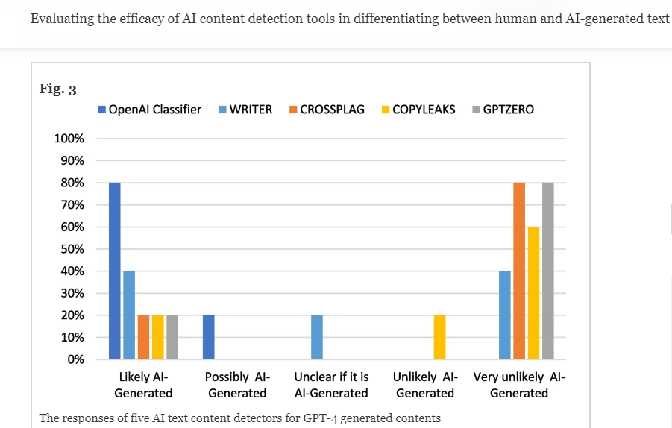
Other Solutions
Most prominent AI detectors:
GPTZero
Copyleaks
CrossPlag
Detectors do not perform well against GPT 4.0
Many false negatives and uncertain classifications

Slide 5
Other Solutions Continued
How these AI detectors work
GPTZero:
Amount of predictability in the text
Looks at the variance in the sentences, AI generated text typically has less variety
Copyleaks
Scans the document against different sources to see if it matches anything
Sentence by sentence detection against human writing
CrossPlag
Text analysis using Natural Language Processing
Using a dataset created by human and AI content
Pros: Detect well on older GPT generations
Cons: Fail on GPT 4.0 and paraphrased AI generations, inconsistencies

Slide 6
Demo of current solutions
GPTZero
CopyLeaks: https://copyleaks.com/ (doesn't seem to work without subscription)
CrossPlag: https://app.crossplag.com/individual/detector
Sample AI generated text: “Playing basketball is always exciting. The moment I step onto the court, I feel the energy rise. The sound of the ball bouncing and sneakers squeaking on the floor makes me focus on the game. I enjoy dribbling the ball, passing to my teammates, and shooting for the basket. Each time the ball goes in, it’s a rush of excitement. Working with the team, moving fast, and thinking on my feet keeps me engaged. Basketball is not just a sport to me, it’s a fun way to stay active and connect with others.”

Slide 7
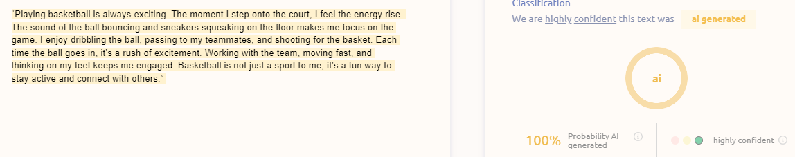
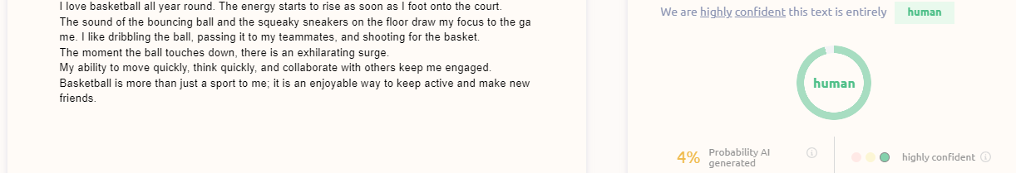
AI Detectors with paraphrasing continued

Slide 8
Why Is Mine Better?
Model that is more accurate on GPT 4.0
Current detectors struggle on this
Model that is better with paraphrased GPT 4.0
GPT 4.0 content that people paraphrase but the meaning is the same
Model that gives more consistency in detecting GPT 4.0 content

Slide 9
Novelty
Using retrieval methods (not used on common AI detectors) on GPT 4.0
Using a database of AI generations to tell whether text is a paraphrasing of AI generated text
Use cosine similarity scores
Find any matches to previous generations
Accuracy will remain high even as the amount of paraphrasing goes up
Use on “mixing attacks”
Texts that has both human written elements and AI generated text
Higher accuracy than current AI detecting algorithms have

Slide 10
Impact
Used in school by teachers
A more reliable way to check AI content
Trustworthy source of AI detection
Maintains integrity
Creates a fair learning environment

Slide 11
Method
Store Word2Vec encoded sequences of text that were generated by GPT 4.0 in database in a web server
Feed in input text
Use a Word2Vec encoder to encode input text
Check to see if input text matches database text (cosine similarity)
Set the threshold (T), if the text score is higher than T, then it is judged as not similar
Output whether the text is detected as GPT 4.0 generated or not

Slide 12
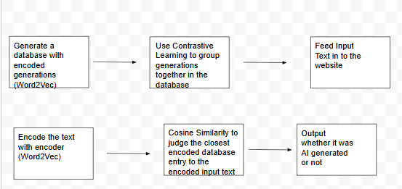
Method: Systems Architecture

Slide 13
Encoding
Encoding using a Word2Vec Model
Finds the semantic relationship between words
Captures the meaning of the word
2 Layer Neural Network
Continuous Bag of Words
Getting a vector representation of words
Uses large corpus of text

Slide 14
Database
Created using generations around a prompt or topic
Teacher can put a prompt in and generate AI responses
Can generate hundreds of pieces of text for the database
Take the LLM output and encode it as a vector
Store the vector in the database (Word2Vec)

Slide 15
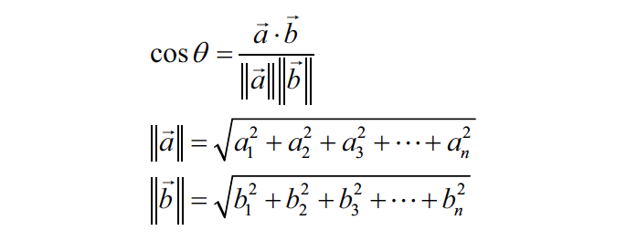
Contrastive Learning
Positive and Negative pairs
Positive pairs are associated closer together
Paraphrased AI generations and AI output
Negative pairs are further
Human and machine written text
Distance can be used to see similarities between text
Take closest entry
Compare input to closest piece of text in the database with cosine similarity

Slide 16
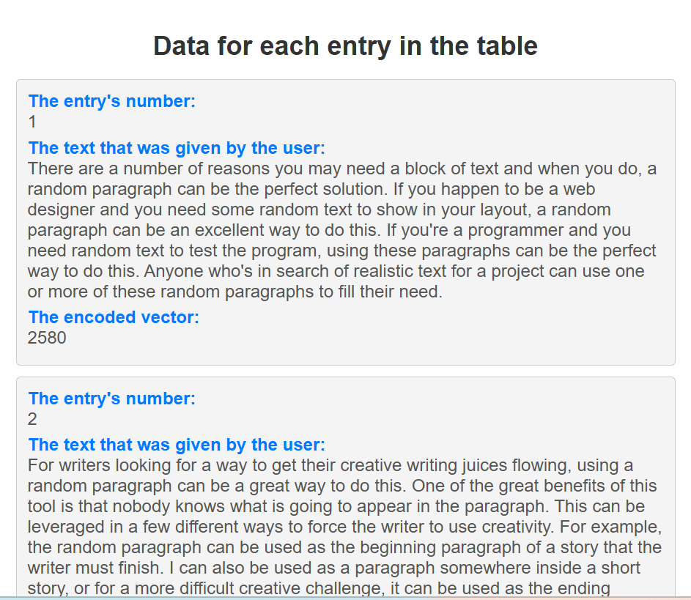
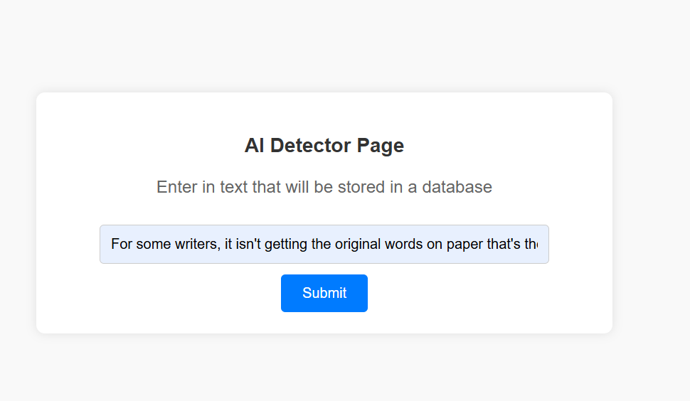
Demo

Slide 17
Results
I hope to measure 85% accuracy or better on detecting text generated by GPT 4.0
Model takes input text
Could be paraphrased
Could be mixed in with human content,
Model tells whether it was AI generated or not
Expect better performance than current AI detectors

Slide 18
Limitations
Text not generated by students
Text with shorter number of words
Not using watermarking and statistical outlier methods
Other potential AI’s (besides GPT 4.0)
Scalability to more than 15 million generations

Slide 19
Future Work
Improvements in text generated for other things besides school
Use retrieval method along with other methods (watermarking, statistical outlier) to improve shorter text identification
Experiment retrieval methods with other AI’s
Test accuracy with more than 15 million generations

Slide 20
Conclusion
I solved the problem of AI Detection using Retrieval Methods

Slide 21
References
[1] A. Singh, "A Comparison Study on AI Language Detector," 2023 IEEE 13th Annual Computing and Communication Workshop and Conference (CCWC), Las Vegas, NV, USA, 2023, pp. 0489-0493, doi: 10.1109/CCWC57344.2023.10099219.
[2] D. Dukić, D. Keča and D. Stipić, "Are You Human? Detecting Bots on Twitter Using BERT," 2020 IEEE 7th International Conference on Data Science and Advanced Analytics (DSAA), Sydney, NSW, Australia, 2020, pp. 631-636, doi: 10.1109/DSAA49011.2020.00089.
Elkhatat, A.M., Elsaid, K. & Almeer, S. Evaluating the efficacy of AI content detection tools in differentiating between human and AI-generated text. Int J Educ Integr 19, 17 (2023). https://doi.org/10.1007/s40979-023-00140-5
Krishna, Kalpesh, et al. "Paraphrasing evades detectors of ai-generated text, but retrieval is an effective defense." Advances in Neural Information Processing Systems 36 (2024).
Perkins, Mike, et al. "Simple Techniques to Bypass GenAI Text Detectors: Implications for Inclusive Education: Revista De Universidad y Sociedad Del Conocimiento." International Journal of Educational Technology in Higher Education, vol. 21, no. 1, 2024, pp. 53. ProQuest, https://www.proquest.com/scholarly-journals/simple-techniques-bypass-genai-text-detectors/docview/3101842024/se-2, doi:https://doi.org/10.1186/s41239-024-00487-w.
[6] GPTZero: https://gptzero.me/
CopyLeaks: https://copyleaks.com/ (doesn't seem to work without subscription)
CrossPlag: https://app.crossplag.com/individual/detector

Slide 22
Q&A

Slide 23
THANKS!

